Slide 1
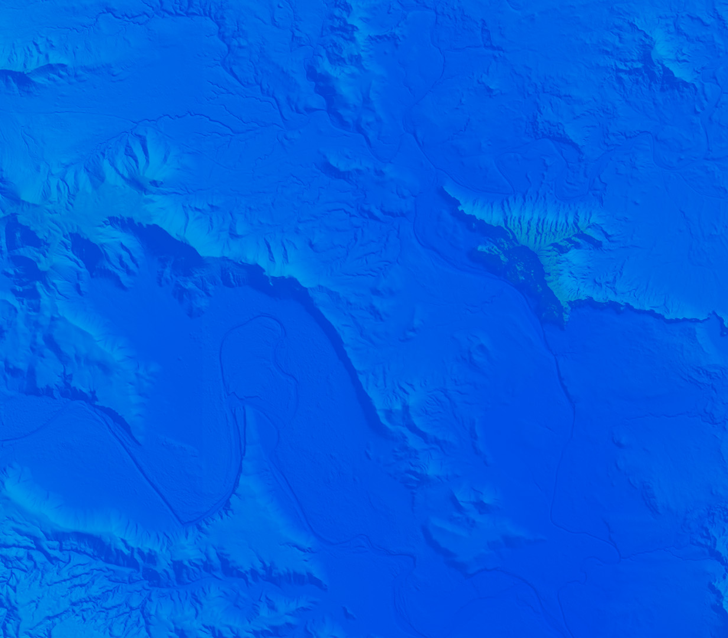

Developer Summit Synopsis Mark Grinberg 3/21/25

Slide 2

Agenda
General Overview
What is ESRI
Software Models / Apps
APIs / SDKs Documentation
Demo
No Components vs. Components
Calcite
Feature Service & Auth
3D Boston
Conclusions / Resources / Questions

Slide 3

What is ESRI?
I promise, I’m not a fanboy but…
Founded in 1969 by Jack Dangermond
“Environmental Systems Research Institute”
As of 2011, ESRI has 40% of GIS marketshare
~30% of revenue goes towards R&D annually
Arc/Info -> ArcMap -> ArcPro

Slide 4
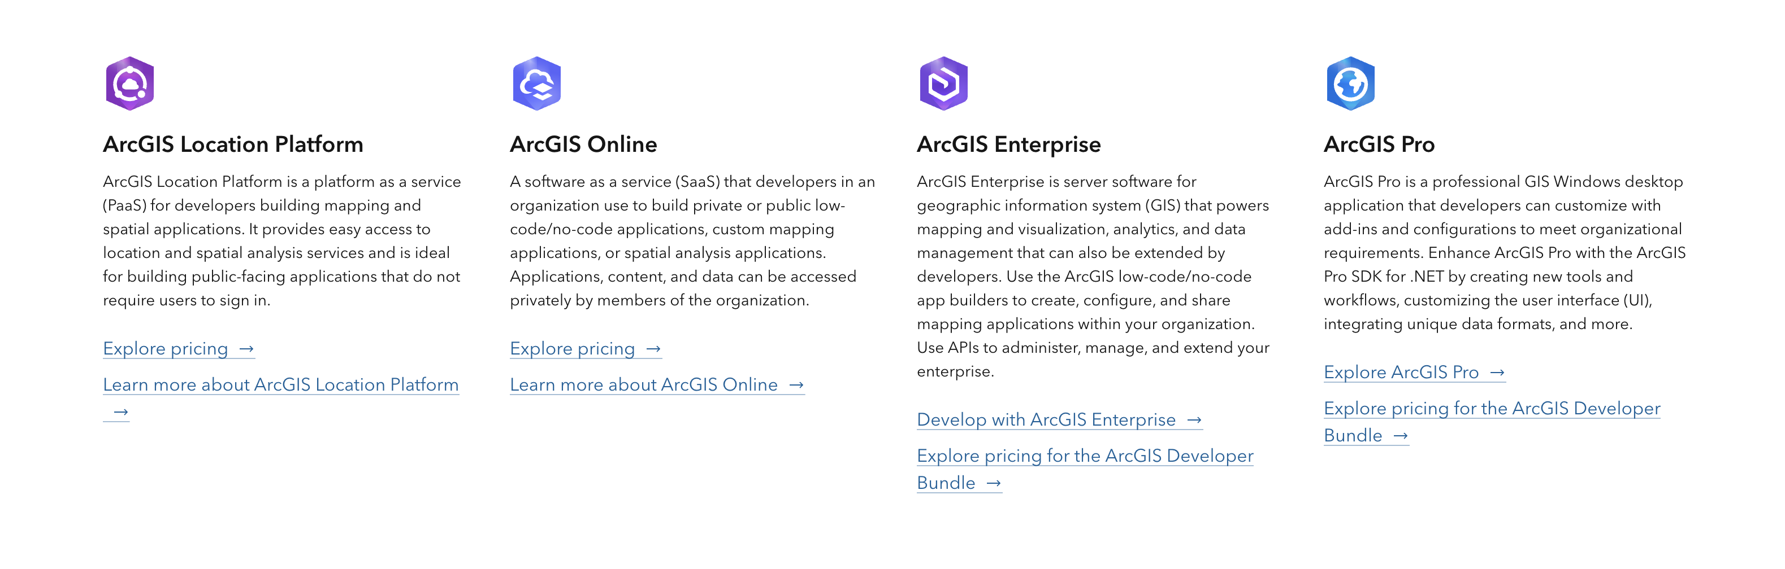
What is ESRI: Software Models

Slide 5
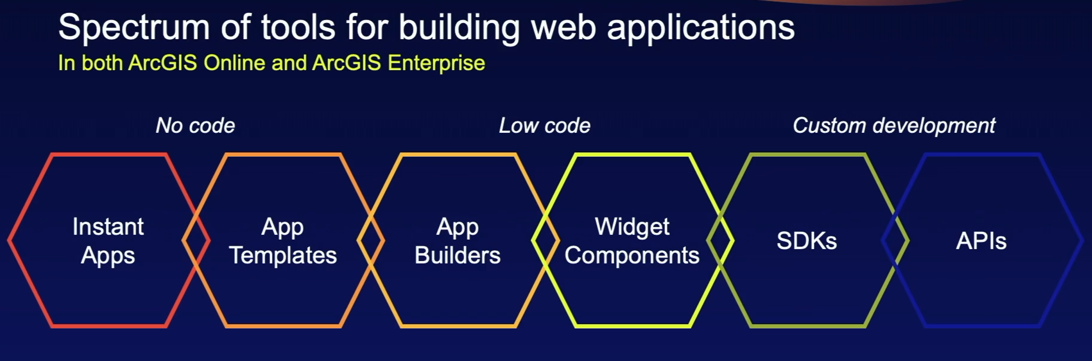
What is ESRI: “Apps”

Slide 6
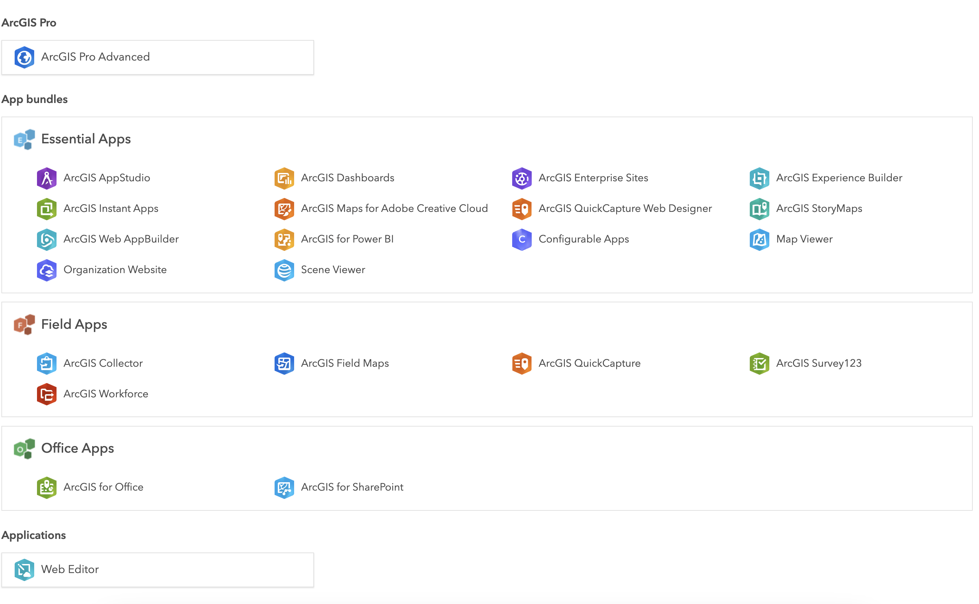
What is ESRI: “Apps”
https://www.esri.com/en-us/arcgis/products/index

Slide 7
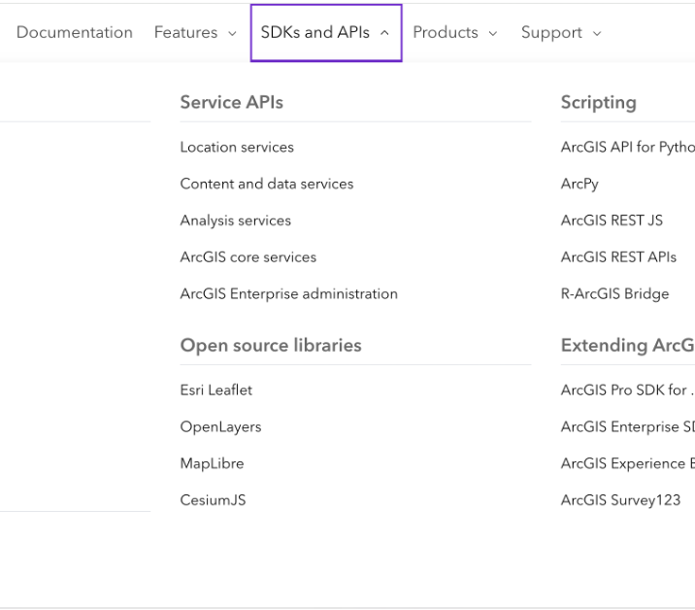
SDKs, APIs, Documentation
https://developers.arcgis.com/documentation/
Notes:
Actually walk through documentation

Slide 8
ESRI Dev Summit
Best Sessions:
Accessibility for Web Maps
Web Editing
3D Mapping
Speedgeeking
Geometric Operators
ArcGIS Routing Services w/ OpenLayers
Time Data w/ the JavaScript API
Working with Imagery using the JavaScript SDK
2D Visualization Techniques
Testing for Success
Notes:
Accessibility:
WCAG 2.1, currently 2.2, goes into A, AA, AAA
We use Aria = Accessible Rich Internet Applications
…could be a whole nother dev lunch using Aria-live, aria-describedby, aria-label. No aria is better than bad aria though!
Focus trapping, animations, etc.
Web Editing:
Editing a feature service, very cool, easy to apply edits and store your data in this way with many built in components for doing so.
3d Mapping:
ESRI’s 3D capabilities are quite good – because the data and 3d meshes exist close to where you are doing the data. More on this later.
SpeedGeeking
Google Gemini AI questions, Agar.io on a map, Calcite Templates.
Geometric Operators in ESRI
How to do things like buffers, measurements, projections, contains/crosses/etc. client-side
Routing Services with OpenLayers:
Using Location Platform Services to do routing in OpenLayers
Time Data w/ ESRI Javascript API:
Updating with pushes and pulls (streamLayers, can connect to a stream service or a custom websocket service)
Imagery:
Different types of imagery in ESRI, how it is handled, how to query, etc.
2D visualization Techniques
CIMSymbol and Renderers, Color Maps, etc.
Testing for Success:
Non-ESRI testing!

Slide 9


Slide 10
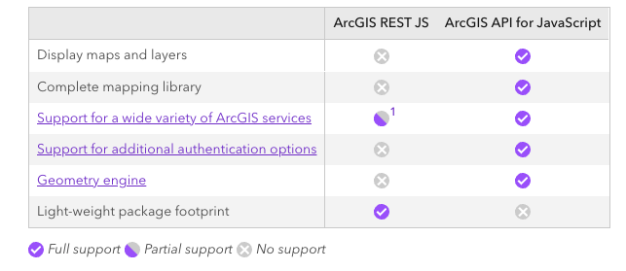
Demo
https://developers.arcgis.com/arcgis-rest-js/faq/#fn:support-table-1:0

Slide 11
Conclusions
“It is tempting, if the only tool you have is a hammer, to treat everything as if it were a nail.”
Advantages of using ESRI “stack”:
Existing Infrastructure / Data
Infrastructure and Data live together
Calcite?
Disadvantages
Documentation can often be lacking
Costly, even with location platform services
Can mix and match technologies (feature services in OpenLayers / Leaflet)
Opportunities to use ESRI Javascript API to make our lives a little easier…maybe?
Ultimately, having skills across various technologies allows us to advise clients/PMs with the best possible options and their pros/cons.

Slide 12
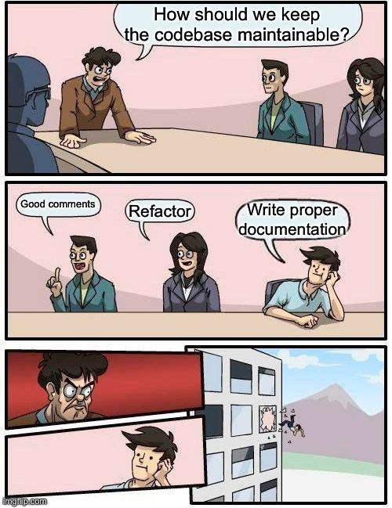
Documentation & Resources
Github Repo containing demo code & notes:
https://github.com/sanborn/esri_devsummit_2025
Documentation and Samples:
https://developers.arcgis.com/javascript/latest/
https://developers.arcgis.com/javascript/latest/sample-code/
https://github.com/Esri/jsapi-resources
https://github.com/EsriDevEvents
VSCode Snippets:
https://marketplace.visualstudio.com/items?itemName=Esri.arcgis-maps-sdk-js-snippets
ESRI Javascript API Product Blog:
https://www.esri.com/arcgis-blog/products/js-api-arcgis/

Slide 13

Questions?

Slide 14

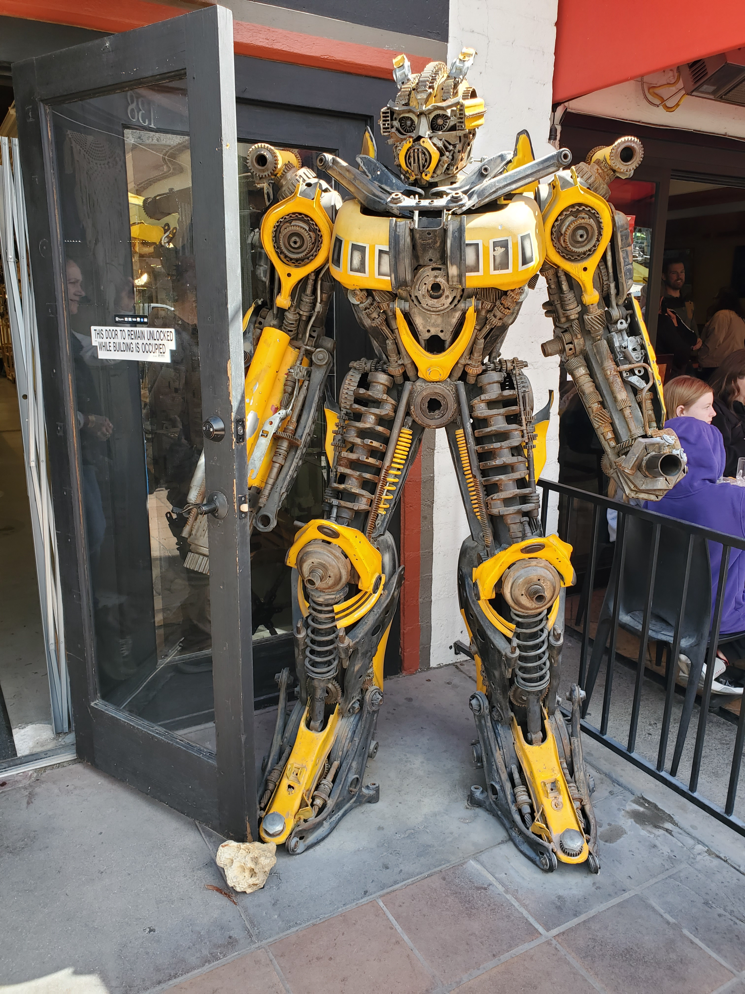


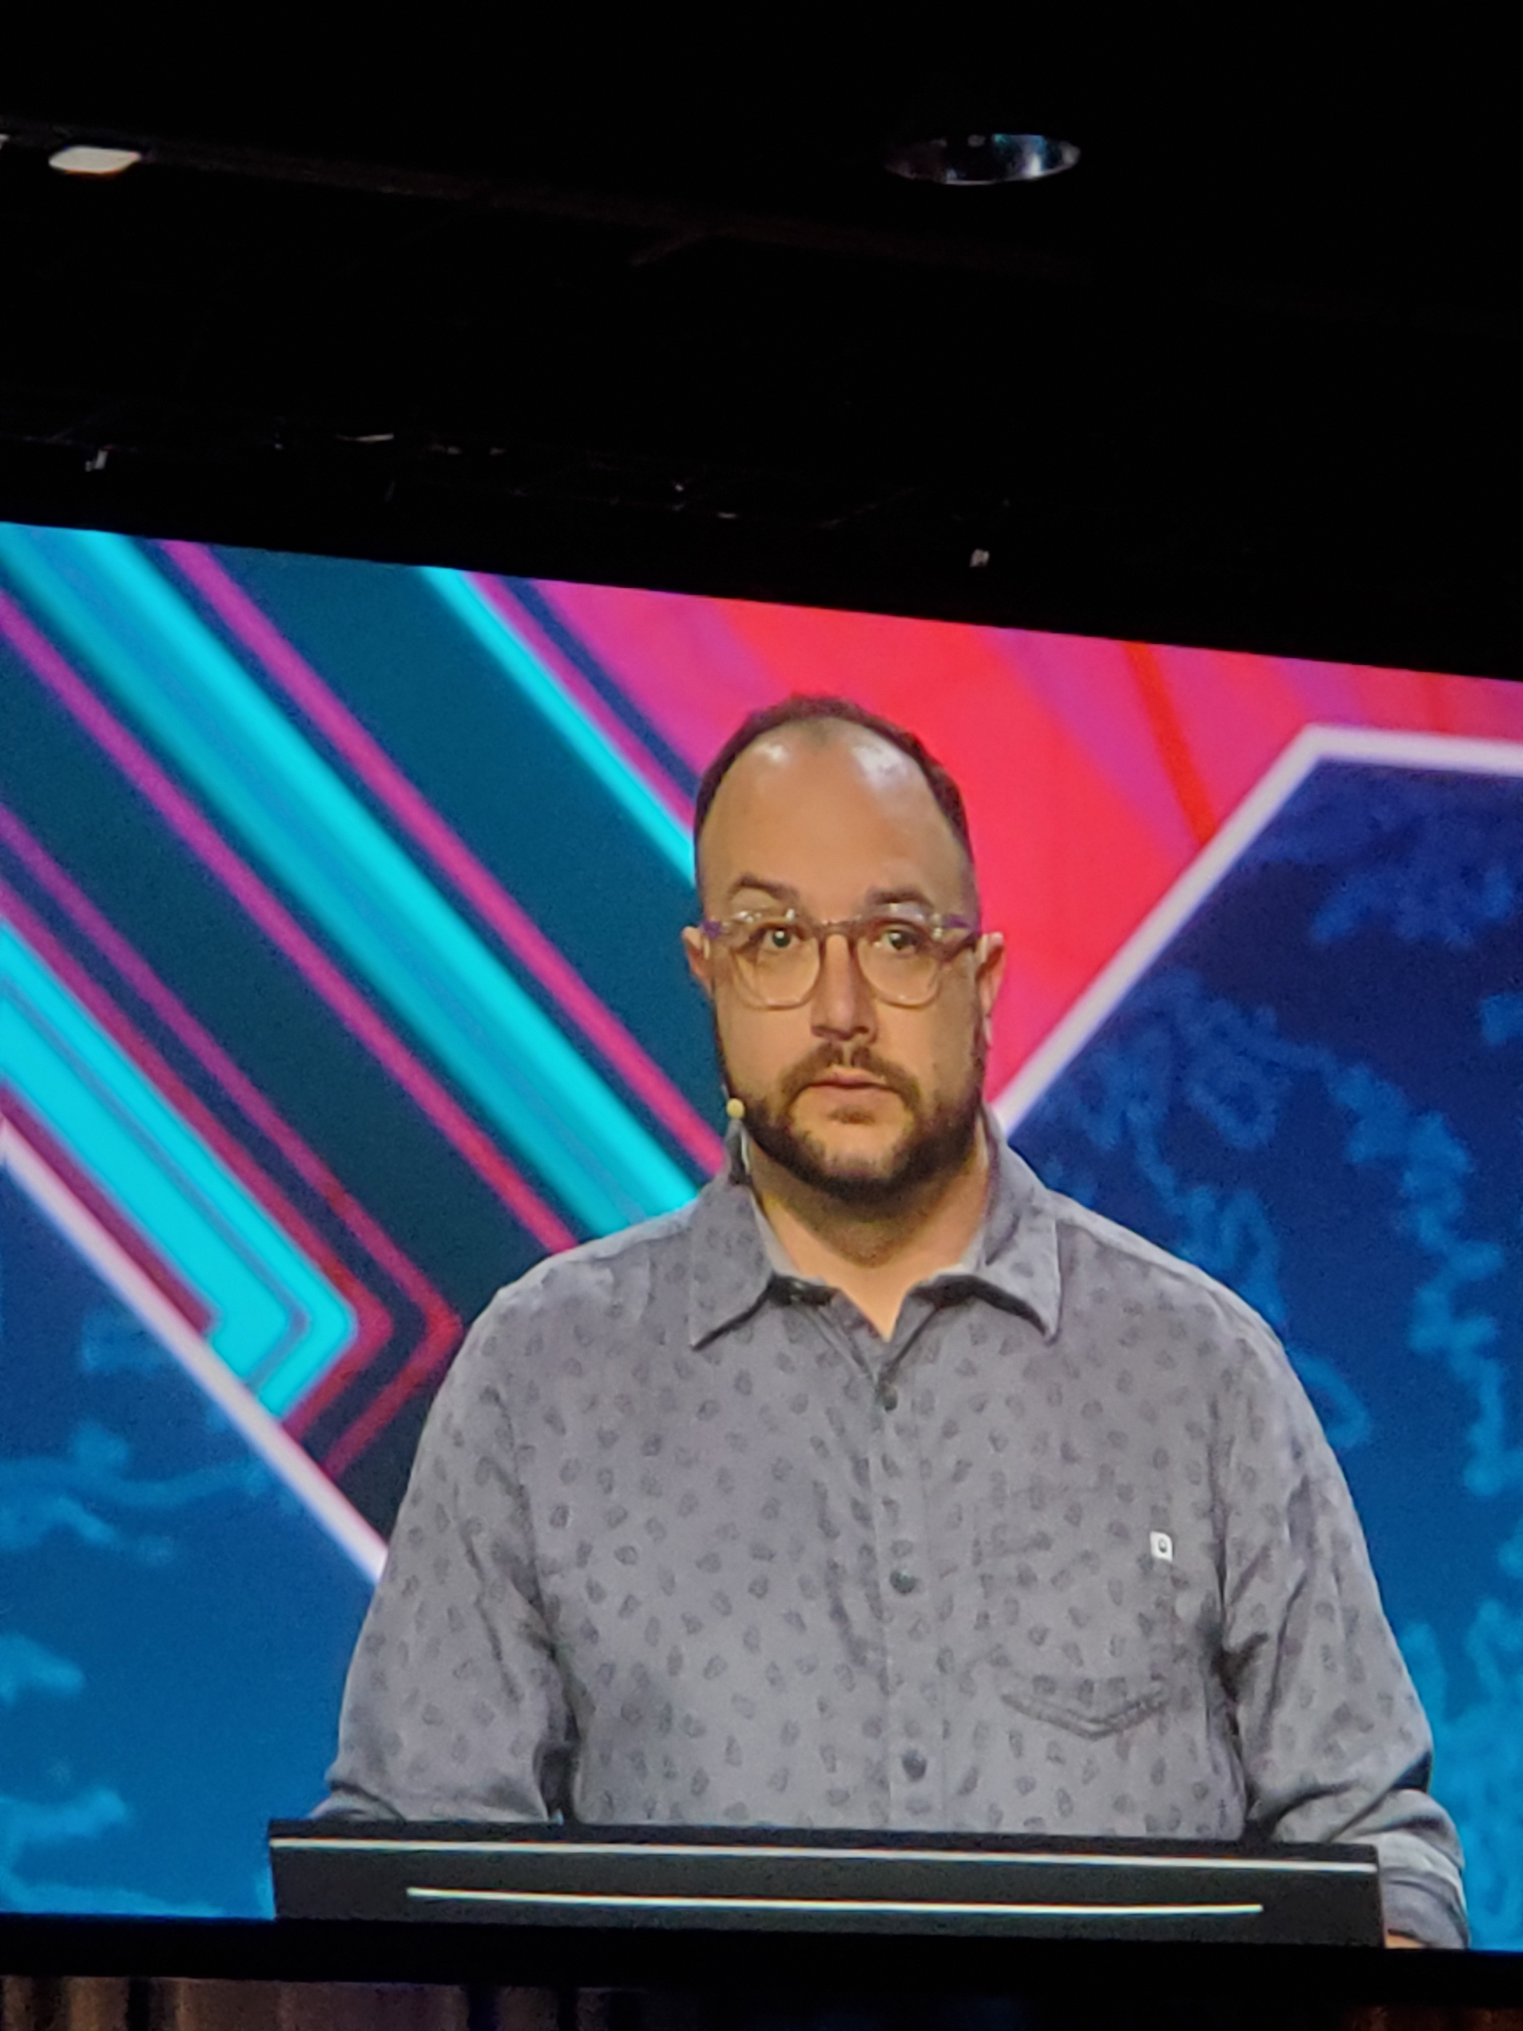
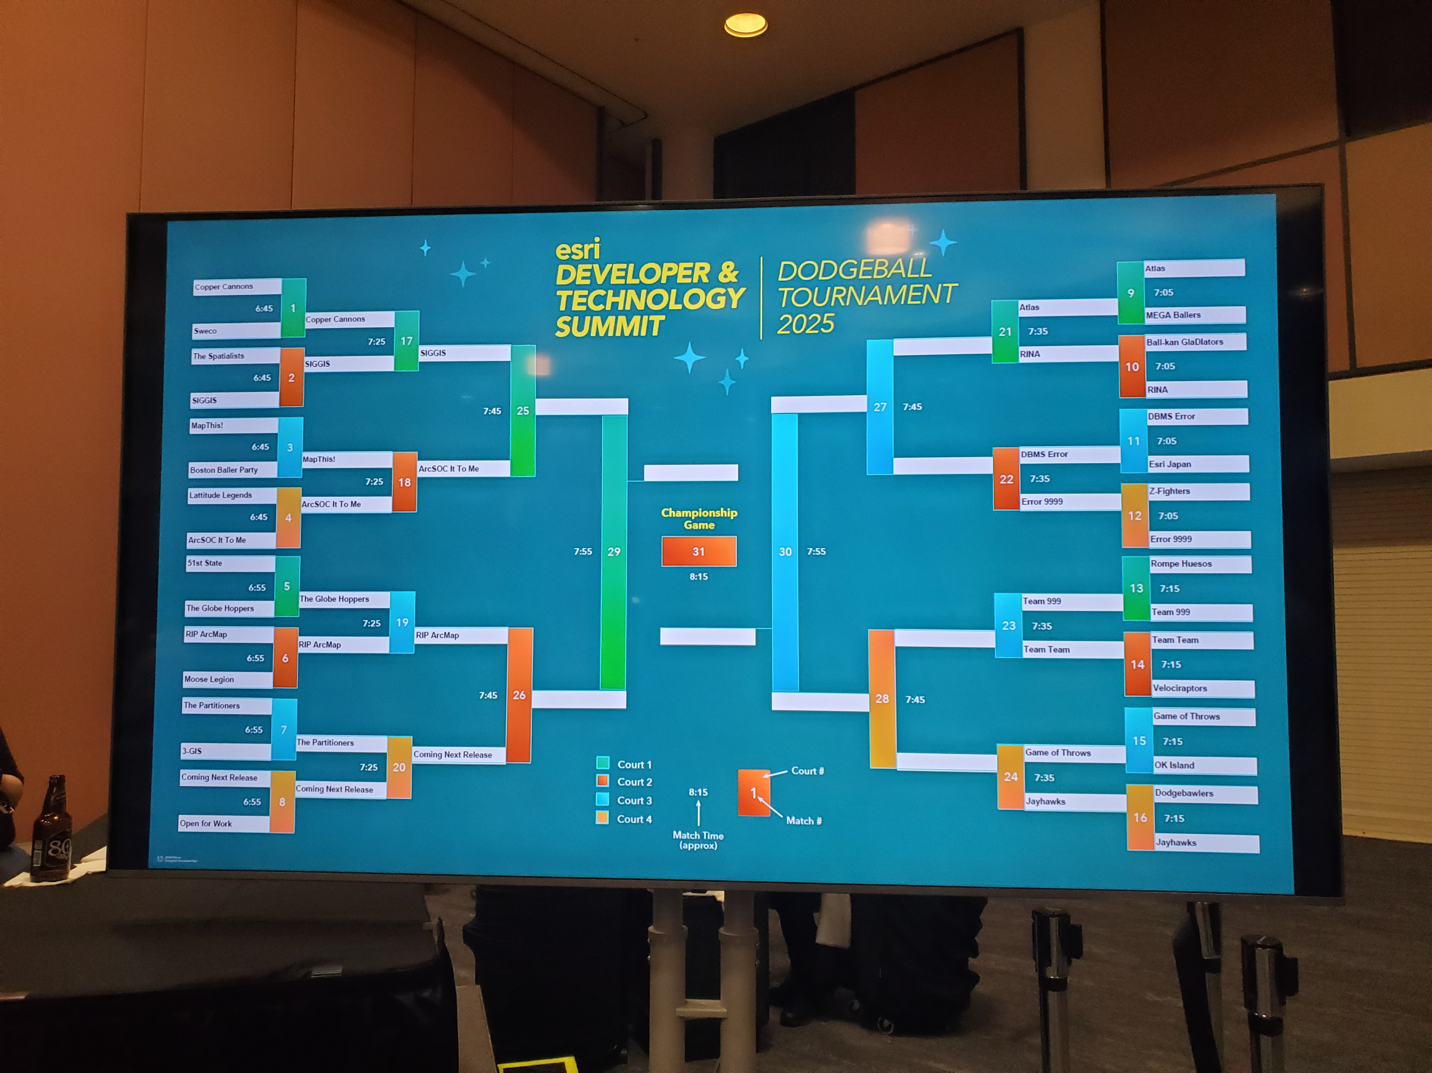
Fun & Miscellany

